Slide 1



NRI INSTITUTE OF TECHNOLOGY
(An Autonomous Institution, Approved by AICTE, Permanently Affiliated to JNTUK, Kakinada)
Accredited by NBA (CSE, ECE & EEE), Accredited by NAAC with ‘A’ Grade ISO 9001: 2015 Certified Institution
Pothavarappadu (V), (Via) Nunna, Agiripalli (M), Krishna Dist., PIN: 521212, A.P, India
RESUME ANALYSIS AND CANDIDATE RANKING SYSTEM
Project Batch: 4 Project Guide:
S. V. MADHAVA REDDY (20KN1A4255) Dr SEVA SREEDHAR BABU
R. MOUNIKESWARI (21KN5A4205)
T. SANDEEP (20KN1A4260)
K. CHANDRA SEKHAR (20KN1A4223)

Slide 2
Abstract
In the contemporary job market, the task of screening resumes and identifying suitable candidates for specific job roles can be time-consuming and labor-intensive. To address this challenge, we propose an Automated Resume Screening and Candidate Ranking System. This system leverages natural language processing (NLP) and machine learning techniques to analyze job descriptions and candidate resumes, extract relevant keywords and features, and rank candidates based on their suitability for the given job role.
The primary objective of our project is to streamline the recruitment process by automating the initial screening of resumes and identifying top candidates efficiently. By automating these tasks, we aim to save time for recruiters and hiring managers, reduce human bias, and improve the overall efficiency of the recruitment process.
The system is built using the Flask framework in Python, allowing for easy deployment and integration with web-based interfaces. Upon receiving a zip file containing resumes and a job description PDF file, the system extracts text data from these files and preprocesses it using techniques such as tokenization and TF-IDF vectorization. The job description and resumes are then analyzed to extract relevant keywords and features.
The Automated Resume Screening and Candidate Ranking System offers a powerful solution to the challenges associated with manual resume screening. By automating the initial screening process and providing recruiters with a ranked list of candidates, the system enables more efficient and informed decision-making in the recruitment process.
2

Slide 3

Introduction
In today's competitive job market, it is crucial for organizations to efficiently identify and attract the most qualified candidates for their open positions. The "Resume Analysis & Candidate Ranking System" is an AI-powered solution that leverages natural language processing (NLP) and machine learning algorithms to streamline the resume screening process, enabling recruiters to make data-driven hiring decisions. This presentation will provide an in-depth overview of the project, including its key components, methodologies, and the technical implementation details.
3

Slide 4
Literature Review
NLP-based Screening
Machine Learning Models
Integrated Frameworks
Existing studies have highlighted the importance of integrating natural language processing (NLP) techniques to enhance resume screening and candidate evaluation. Researchers have explored various NLP-based approaches, such as keyword extraction, entity recognition, and semantic analysis, to extract relevant information from resumes and job descriptions.
Some studies have explored the development of comprehensive frameworks that combine NLP, machine learning, and other techniques to create a holistic solution for automated resume screening. These integrated approaches aim to leverage the strengths of multiple methodologies to deliver a more robust and effective system.
In recent years, the application of machine learning algorithms in resume screening has gained significant attention. Researchers have proposed various models, including classification, ranking, and clustering algorithms, to automate the candidate evaluation process and improve the accuracy of hiring decisions.
4

Slide 5
Existing & Proposed System
Existing System
1
The existing AI-powered resume analysis and candidate ranking system incorporates natural language processing, machine learning, and integration with Applicant Tracking Systems (ATS). It provides a user-friendly interface, continuous improvement through feedback, and prioritizes security, scalability, and reporting.
2
Proposed System
The proposed system aims to enhance the existing solution by further automating the resume screening process. It leverages advanced NLP techniques and machine learning algorithms to extract relevant information from resumes, analyze job descriptions, and rank candidates based on their suitability for the role.
Key Advantages
3
The proposed system offers several advantages, including increased efficiency, consistency in candidate evaluation, scalability to handle large volumes of resumes, and improved accuracy through the application of data-driven analysis techniques.
5

Slide 6
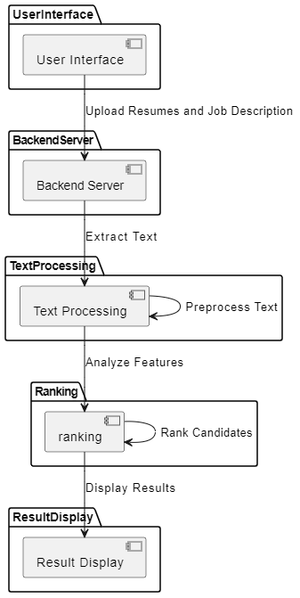
Design
6

Slide 7
Methodology
1
Text Preprocessing
2
Feature Extraction
The system employs text preprocessing techniques, such as tokenization, stopwords removal, and stemming/lemmatization, to clean and standardize the textual data extracted from resumes and job descriptions.
Using natural language processing (NLP) methods, the system extracts relevant features from resumes, including skills, experiences, and qualifications, to create a comprehensive candidate profile.
3
Similarity Calculation
4
Topic Modeling
The system leverages machine learning algorithms, such as TF-IDF and cosine similarity, to measure the similarity between candidate resumes and the job description, enabling effective candidate ranking.
Latent Dirichlet Allocation (LDA) is employed to uncover latent topics and themes within the resume and job description text, providing additional insights for the candidate evaluation process.
7

Slide 8
Technical Implementation
Python Modules
Text Processing
The system utilizes a variety of Python modules, including NLTK for natural language processing, scikit-learn for machine learning algorithms, Flask for web application development, and PyMuPDF for PDF parsing, among others.
The codebase encompasses text preprocessing steps, such as tokenization, stopwords removal, and text extraction from PDF resumes, to prepare the data for further analysis.
Candidate Ranking
User Interface
The system implements TF-IDF vectorization, cosine similarity calculations, and Latent Dirichlet Allocation (LDA) topic modeling to assess the relevance of candidate resumes and rank them accordingly.
The web-based user interface, built using Flask, allows users to upload resumes and job descriptions, initiate the analysis process, and view the ranked list of candidates.
8

Slide 9




Key Algorithms
TF-IDF
Cosine Similarity
Latent Dirichlet Allocation (LDA)
Candidate Ranking
The TF-IDF (Term Frequency-Inverse Document Frequency) algorithm is used to quantify the importance of words in resumes and job descriptions, enabling the calculation of similarity scores.
Cosine similarity is employed to measure the likeness between the TF-IDF vectors of candidate resumes and the job description, providing a numerical assessment of the match.
LDA topic modeling is utilized to uncover latent themes and patterns within the text data, offering additional insights for the candidate evaluation process.
The system combines the TF-IDF and LDA-based similarity scores to calculate a final ranking for each candidate, enabling recruiters to identify the most suitable individuals.
9

Slide 10



System Architecture
User Interface
Backend Processing
Candidate Ranking
The web-based user interface allows recruiters to upload resumes and job descriptions, initiating the automated screening process.
The backend server receives the uploaded data, extracts text, preprocesses it, and applies NLP and machine learning algorithms to analyze the content.
Based on the analysis, the system ranks the candidates according to their suitability for the job role, presenting the results to the user interface.
10

Slide 11
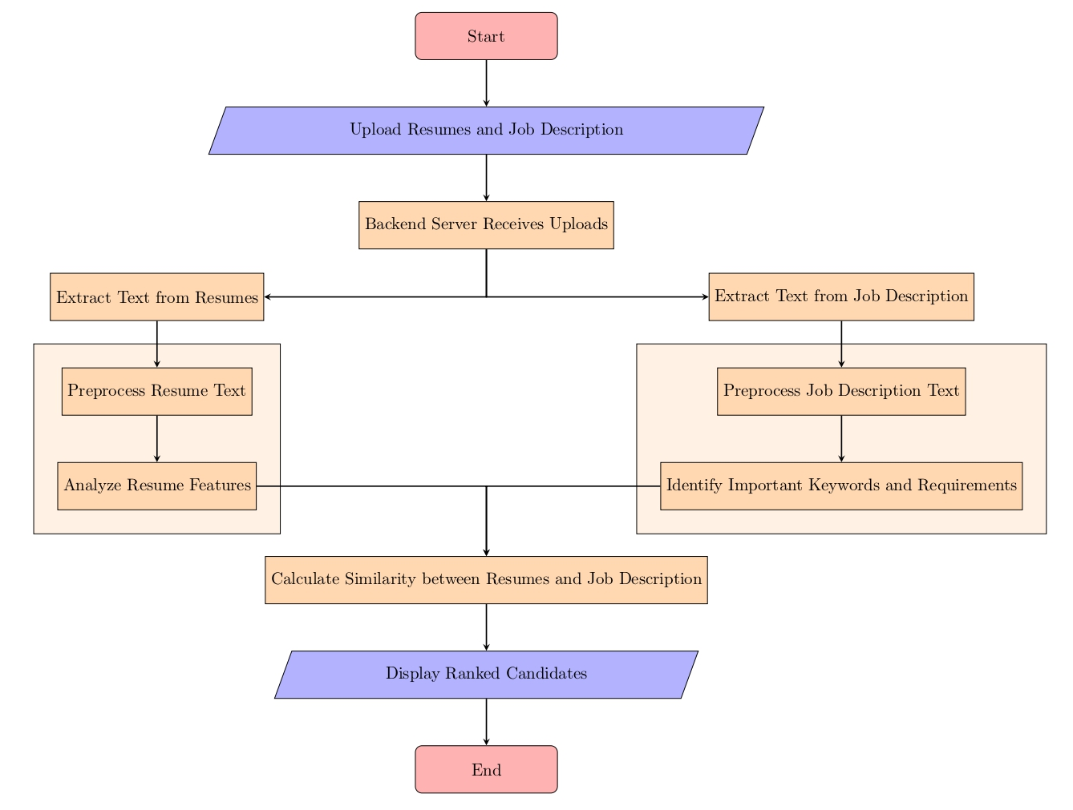
Flow Chart
11

Slide 12
Key Benefits
Improved Efficiency
Consistent Evaluation
Enhanced Scalability
The automated system significantly reduces the time and effort required for manual resume screening, allowing HR professionals to focus on more strategic tasks.
The application of standardized algorithms and criteria ensures consistent and objective assessment of candidate resumes, minimizing the impact of human biases.
The automated system can handle large volumes of resumes, ensuring timely processing of applications even during peak recruitment periods.
12

Slide 13
Execution
13

Slide 14
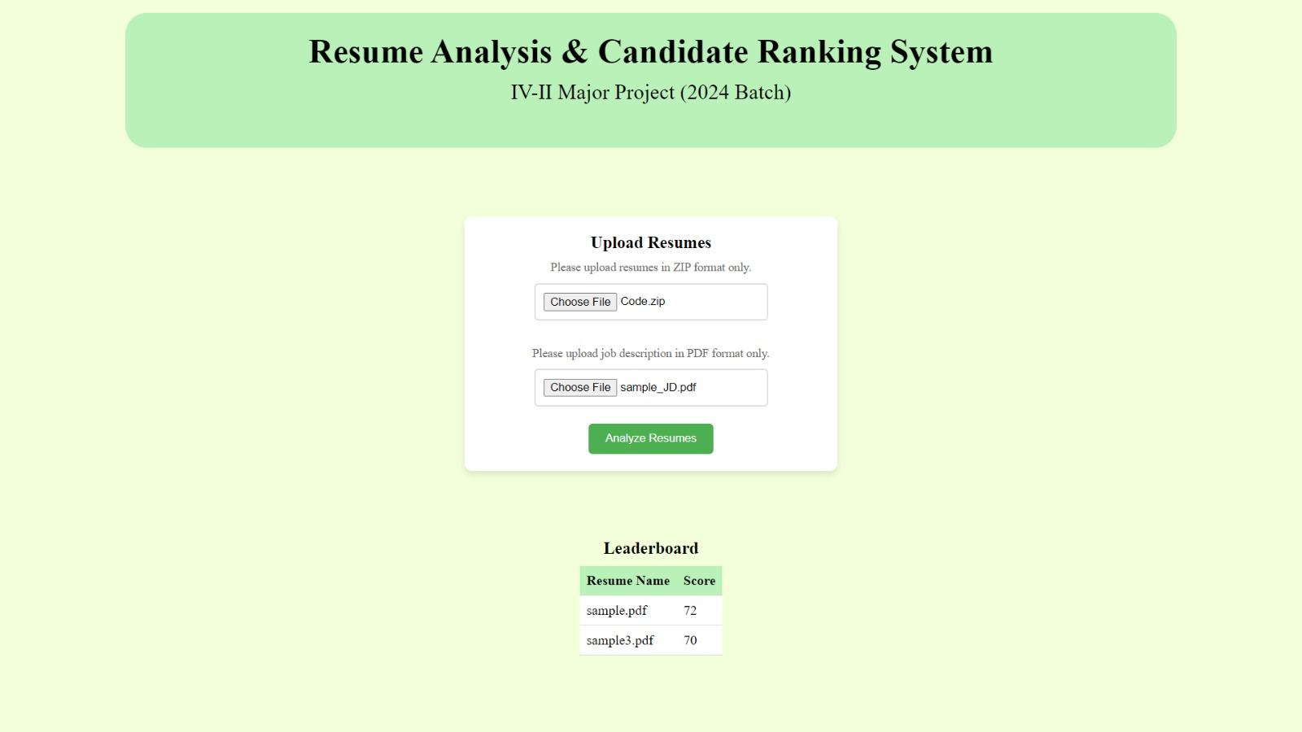
Result
14

Slide 15
Future Enhancements
Continuous Learning
Multi-Lingual Support
Incorporating feedback loops and continuous model updates to enable the system to learn and improve its candidate ranking accuracy over time, adapting to changing job requirements and market dynamics.
Expanding the system's capabilities to handle resumes and job descriptions in multiple languages, catering to a diverse global talent pool and enhancing the inclusiveness of the recruitment process.
Integration with ATS
Explainable AI
Seamless integration with Applicant Tracking Systems (ATS) to streamline the entire recruitment workflow, from resume ingestion to candidate selection and onboarding.
Incorporating explainable AI techniques to provide transparency and interpretability into the system's decision-making process, enhancing trust and enabling informed hiring decisions.
15

Slide 16

Conclusion
The "Resume Analysis & Candidate Ranking System" represents a significant step forward in revolutionizing the recruitment industry. By leveraging advanced natural language processing and machine learning algorithms, the system streamlines the resume screening process, enhances the consistency and accuracy of candidate evaluation, and empowers recruiters to make data-driven hiring decisions. As organizations continue to embrace the power of automation and AI in talent acquisition, this solution offers a compelling pathway to improve efficiency, reduce bias, and identify the most qualified candidates for various job roles. With a commitment to continuous improvement and the incorporation of emerging technologies, the system is poised to elevate the recruitment landscape and deliver transformative outcomes for organizations seeking to build high-performing teams.
16

Slide 17
THANK
YOU

